Slide 1
End-to-End Skill-Based Job Recommendation System using AWS Lambda, DynamoDB, S3, SageMaker, and NLP with Paraphrase-MPNet-Base-v2, Cosine Similarty and Modified Jaccard Similarity

Slide 2
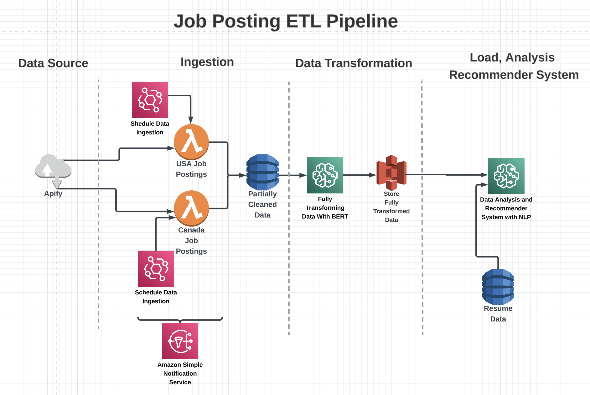

Slide 3


Data Source

Slide 4


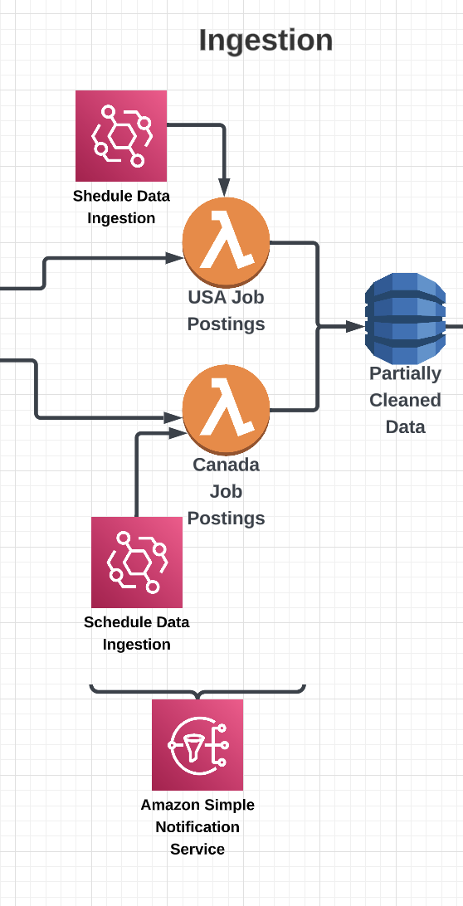
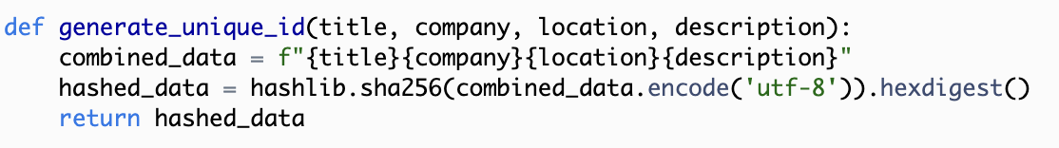
AWS Lambda
The generate_unique_id() function is used to generate a unique identifier for a job posting based on its title, company, location, and description. This unique identifier is used as the primary key for the DynamoDB table where the job postings data is stored, ensuring that each job posting is stored only once and preventing duplicates.

Slide 5

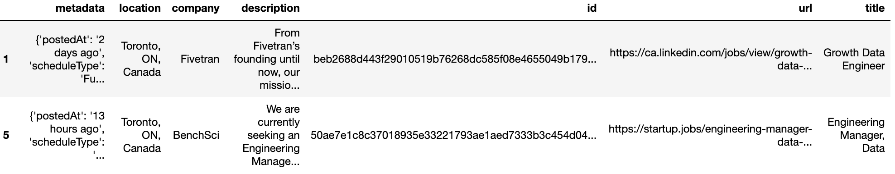
Dynamodb
Note: Not all metadata contains ‘postedAt’ key!

Slide 6

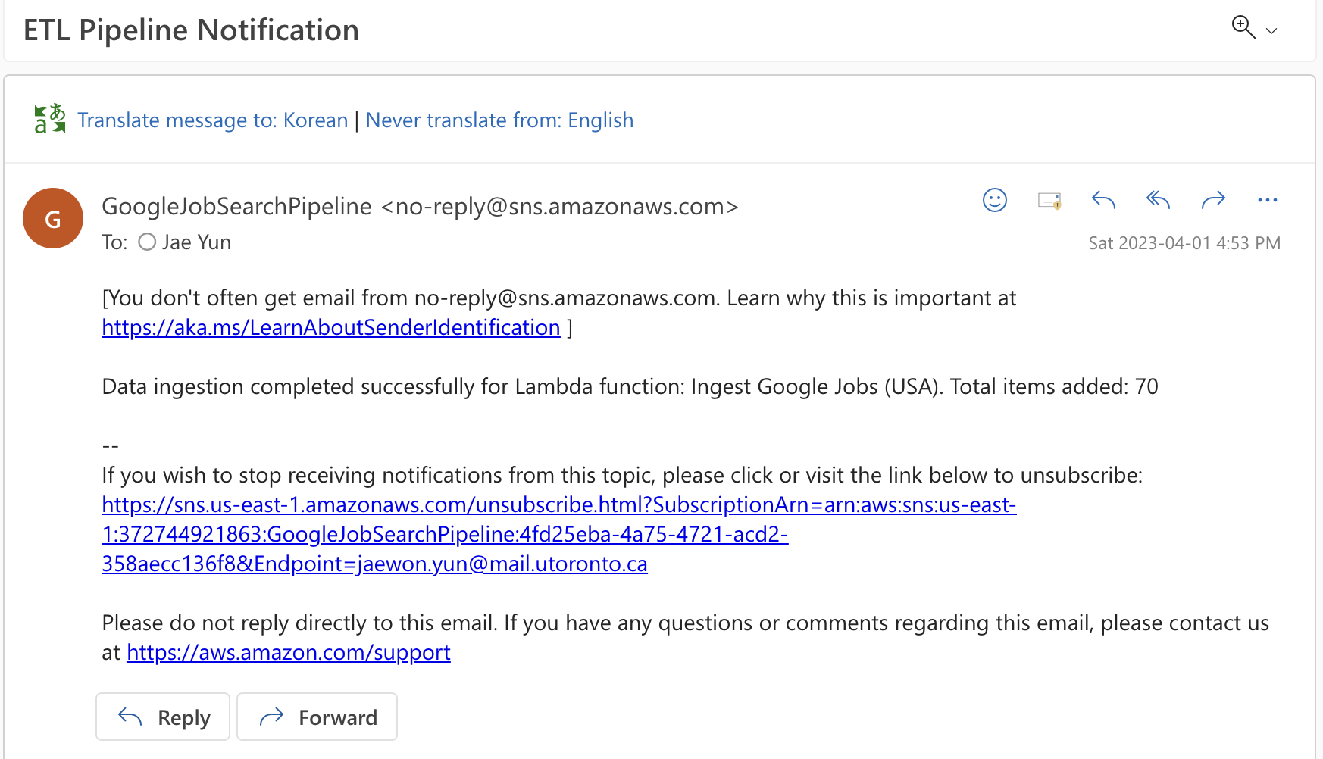
Email Notification

Slide 7
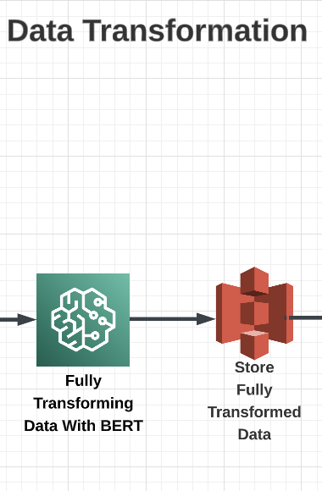
Word Embedding & Transforming Data with AWS Sagemaker
Retrieves job postings data from AWS DynamoDB and S3 and merges them, removing duplicates and identifying unprocessed job postings - do not waste computing power for already transformed data.
Cleans job descriptions, extracts hard skills, and removes duplicated job postings based on company, title, location, and hard skills.
Categorizes job titles into data scientist, data engineer, data analyst, and software engineer categories, and generates embeddings for hard skills.
Categorizes job locations into USA, Canada, or remote.
Transforms the data by converting timezones, formatting dates, and saving the transformed DataFrame to an Amazon S3 bucket as a CSV file.
Key outputs:
Total job postings, processed job postings, and unprocessed job postings.
DataFrame with cleaned job descriptions, extracted hard skills, categorized job titles, and categorized locations.

Slide 8

Optimizing Storage Solutions for ETL Pipelines:
Utilizing DynamoDB for Raw Data and S3 for Transformed Data
Initial raw data storage - Dynamodb
At the beginning of the ETL pipeline, an efficient storage solution is needed to handle structured data and prevent duplicates in real-time. DynamoDB is an excellent choice for this purpose due to its real-time deduplication capability, low-latency access, and strong consistency, which are crucial when working with raw data.
Transformed data storage - S3
After processing and transforming the raw data, a storage solution suitable for large data objects, such as CSV files, and cost-effective for large-scale storage is required. S3 is the ideal choice for storing transformed data because it offers low storage costs per gigabyte, integration with analytics services, and robust data durability and availability.

Slide 9
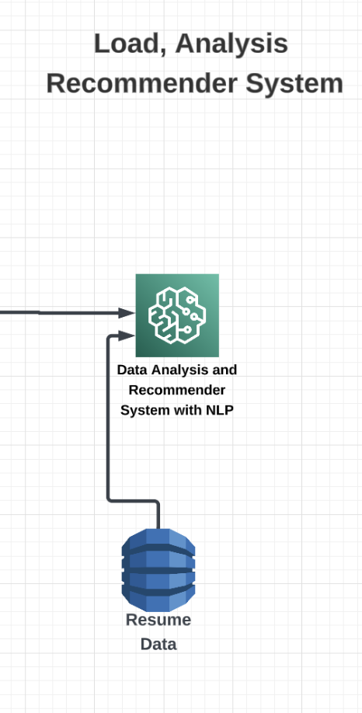
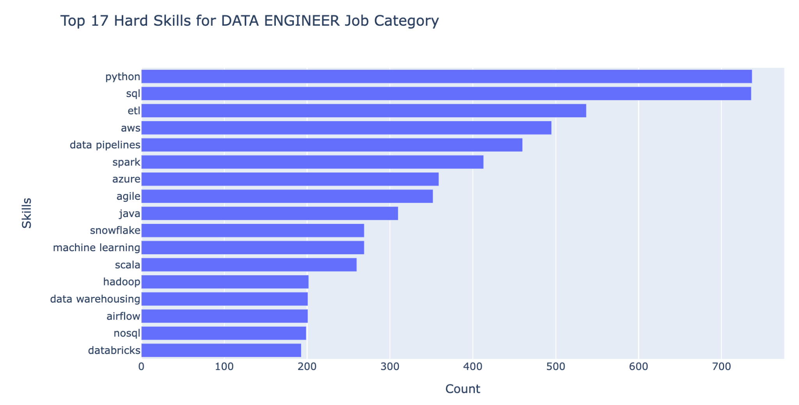
Data Analysis and Sentence Transformer for Recommender Algorithm
Identifying Top Skills by Job Category

Slide 10
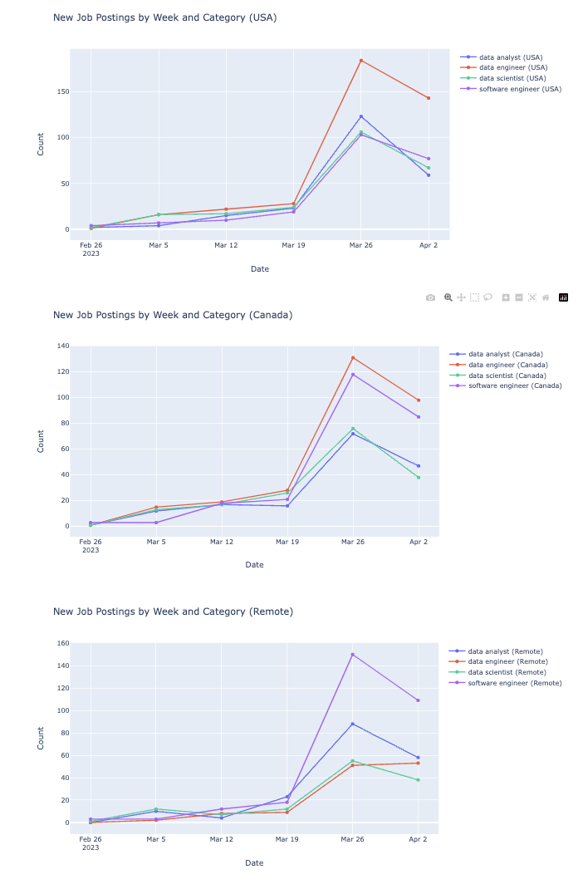
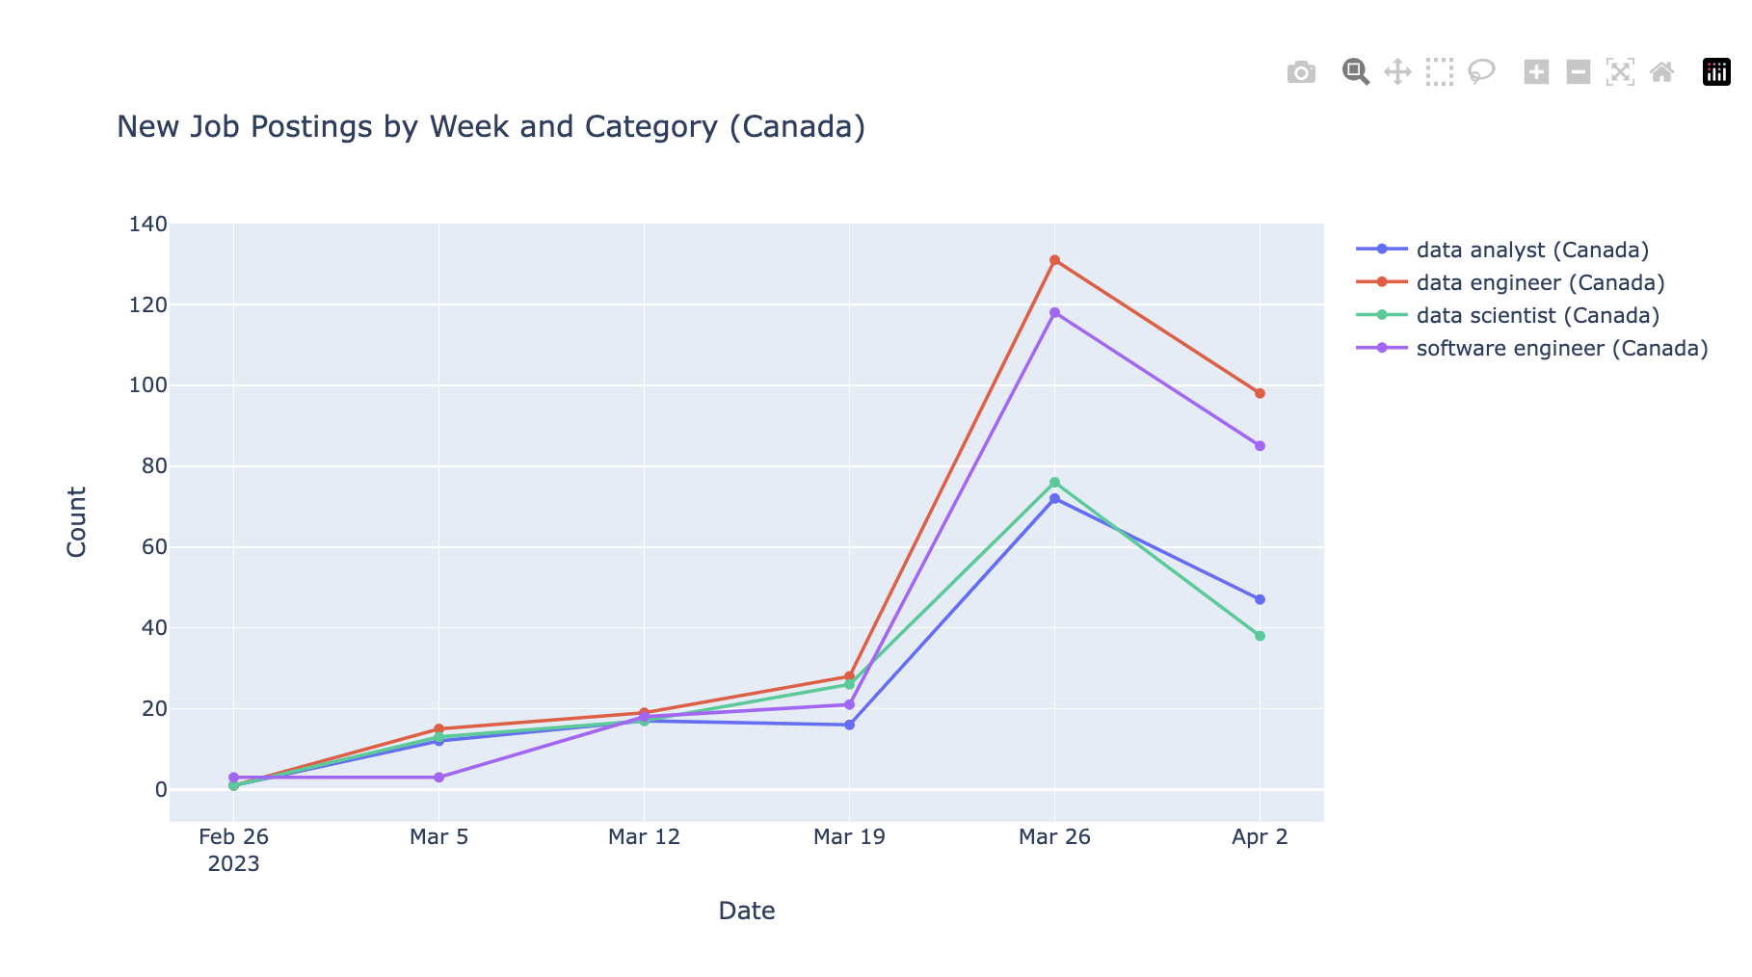
Weekly Job Postings by Location

Slide 11

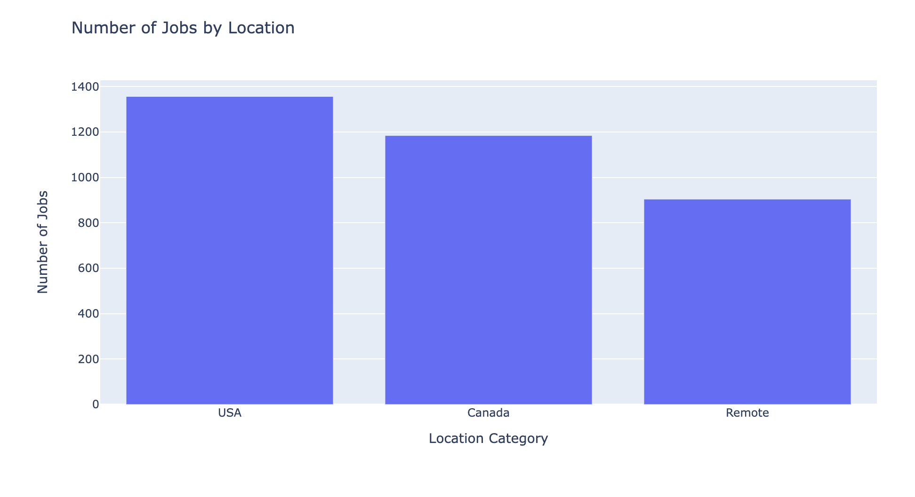
Job Data by Location and Day of the Week

Slide 12
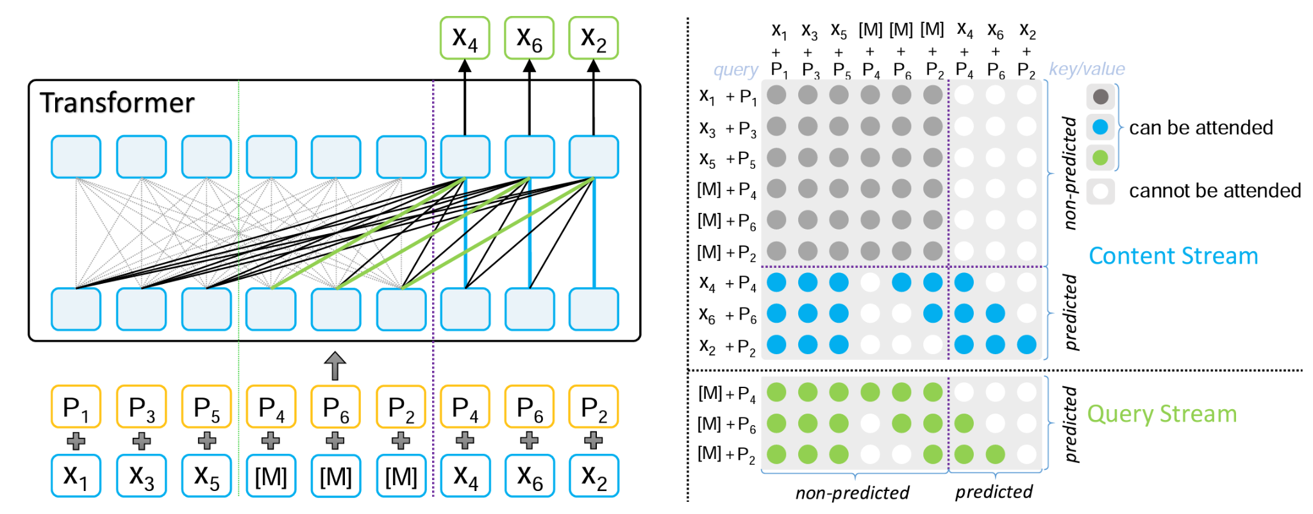
Recommender System using Sentence Transformer
Model: paraphrase-mpnet-base-v2
(a)The structure of MPNet
(b)The attention mask of MPNet
Diagrams from a paper MPNet: Masked and Permuted Pre-training for Language Understanding

Slide 13
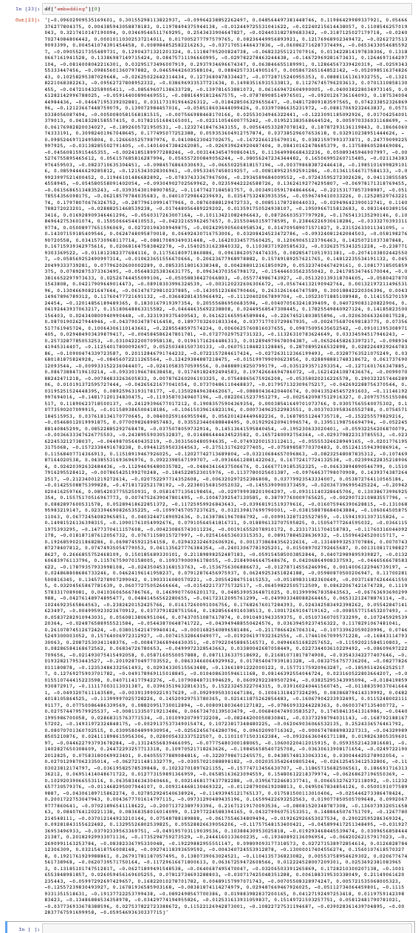
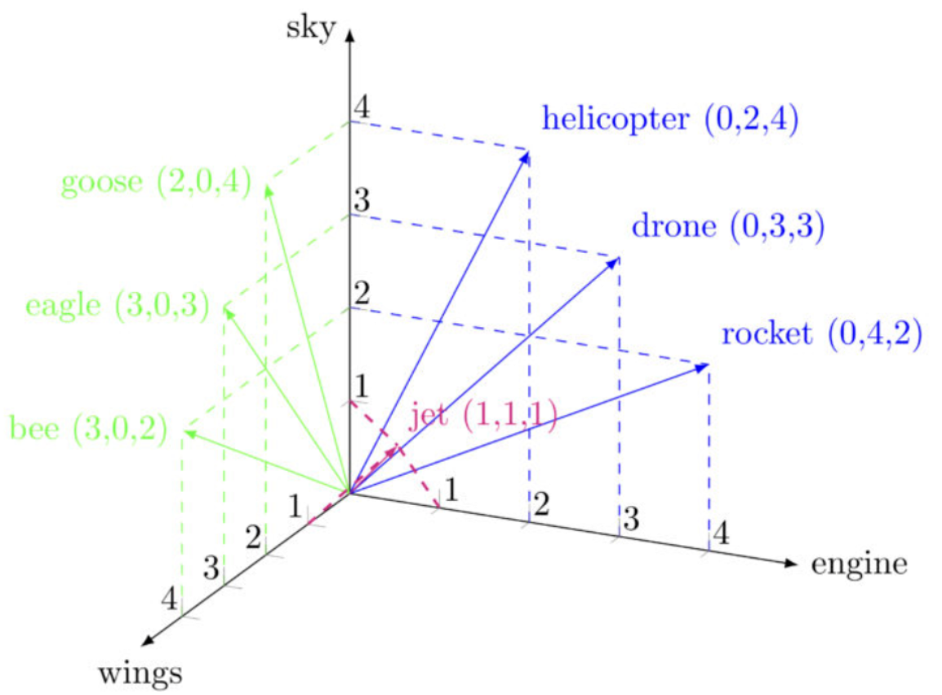
Generating Sentence Embeddings for Skills

Slide 14

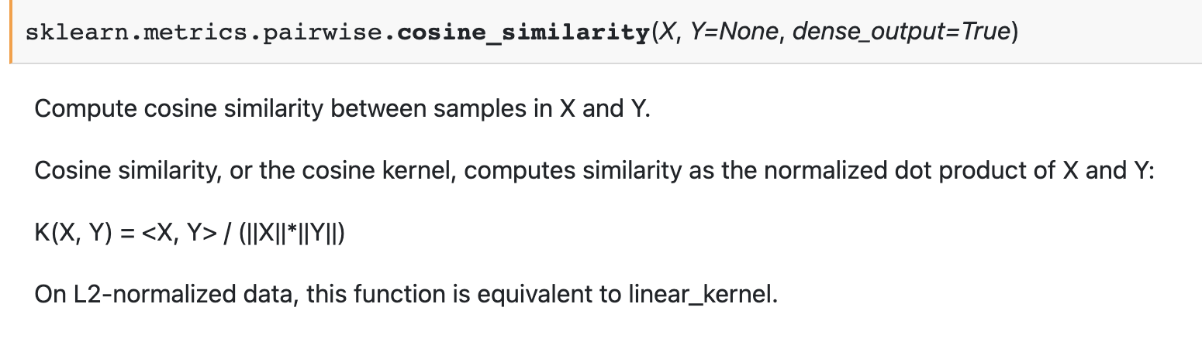
Method 1: Cosine Similarity with Sentence Transformer Embedding

Slide 15
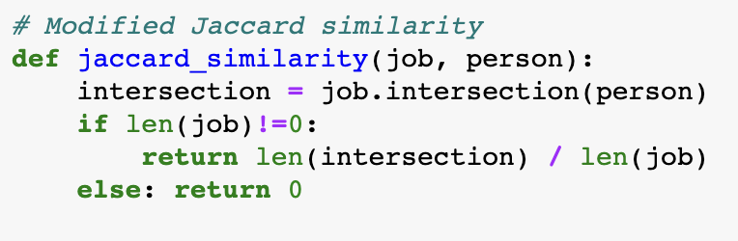
Method 2: Modified Jaccard Similarity
This modified Jaccard similarity score helps determine how well-suited a person is for a particular job based on their skillset, with more emphasis placed on the job's required skills.

Slide 16
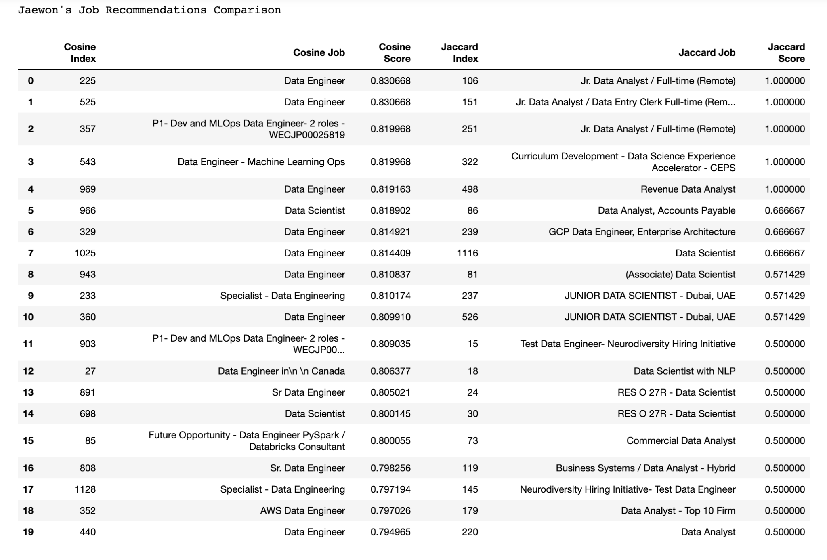

Slide 17
